Slide 1

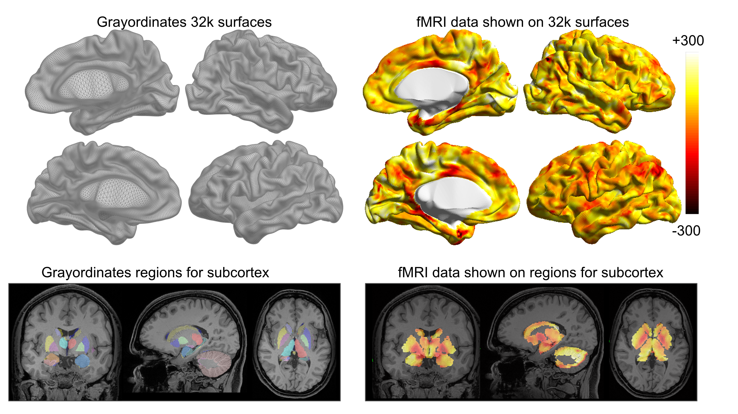
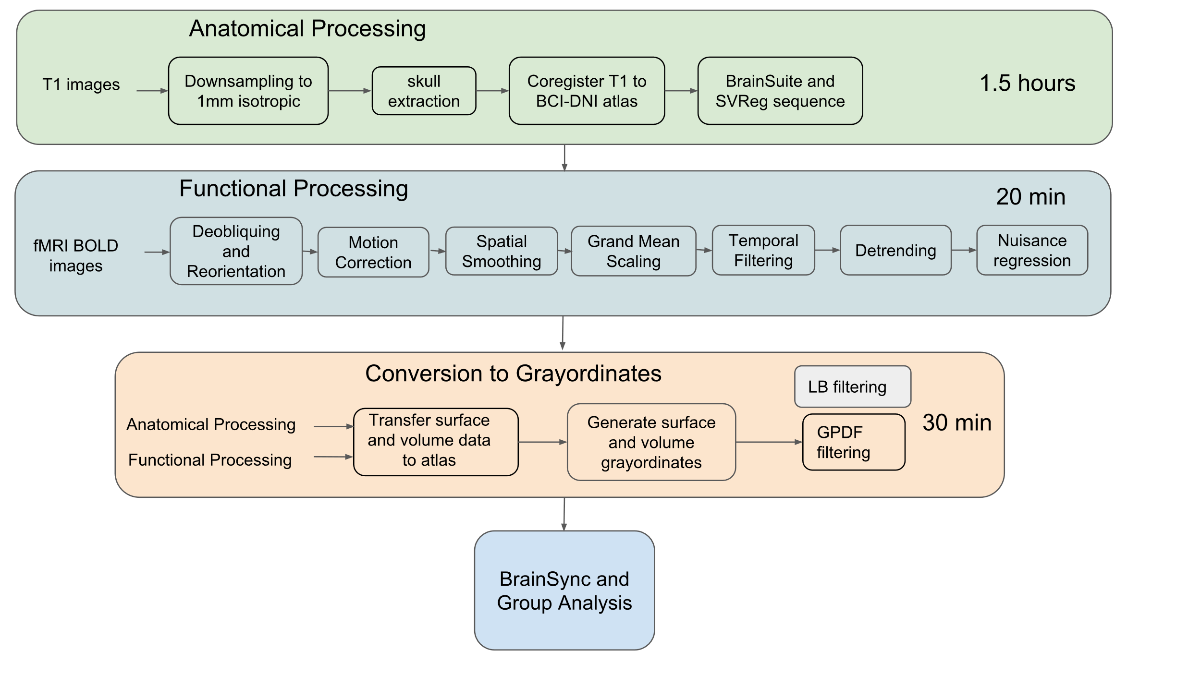
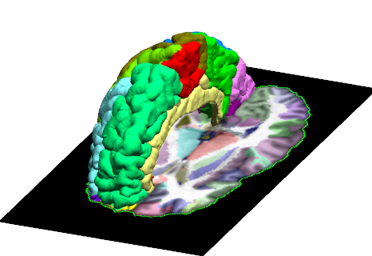
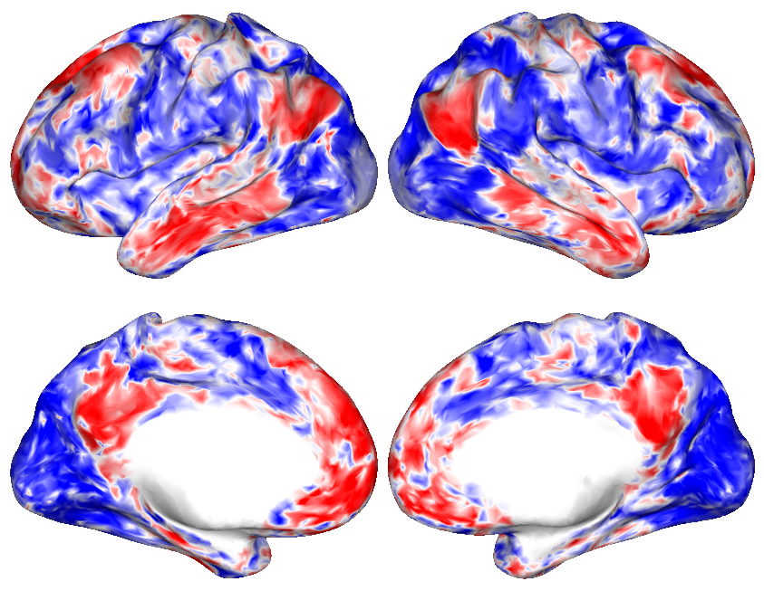
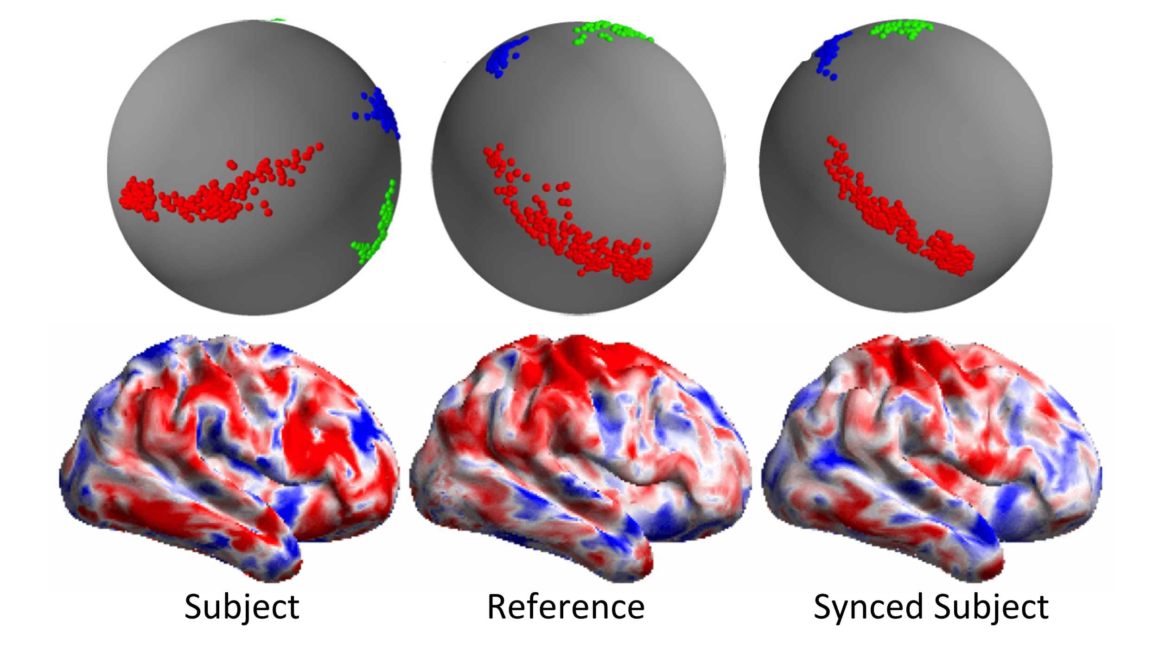
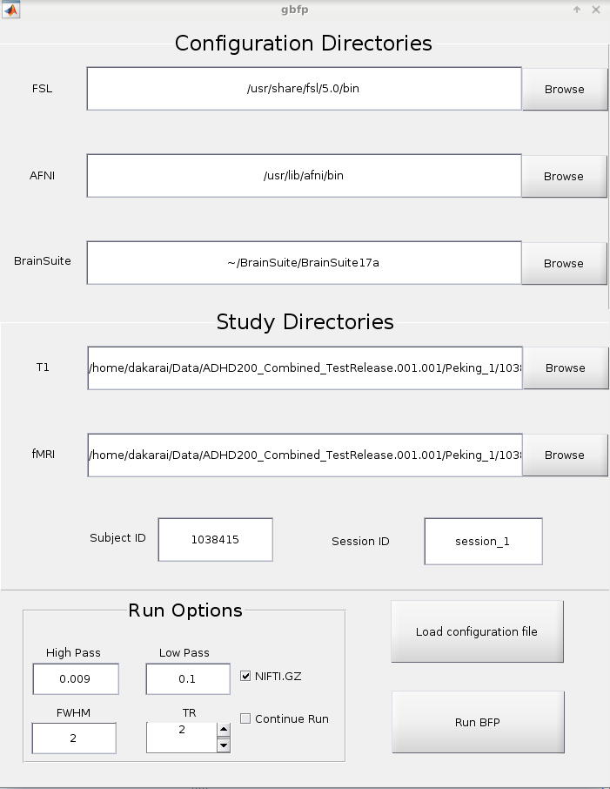
Poster # 2038
BFP: A BrainSuite fMRI Pipeline
Anand A. Joshi¹, Dakarai McCoy¹, Minqi Chong¹, Jian Li¹, Soyoung Choi¹,
David W. Shattuck², Richard M. Leahy¹
¹Signal and Image Processing Institute, University of Southern California, Los Angeles, CA, USA
²University of California, Los Angeles, CA
UCLA Brain Mapping Center
Abstract
Results
The BrainSuite fMRI pipeline (BFP) is an opensource software workflow for processing raw resting fMRI data. The pipeline processes resting fMRI and anatomical (T1) imaging data using a combination of software that includes BrainSuite, AFNI, and FSL, as well as MATLAB scripts.
To facilitate interaction across software packages, the processed fMRI data are represented in a common grayordinate system.
Unique features of the BFP pipeline include cortically-constrained volumetric registration, global PDF-based non-local means filtering (GPDF) [4], and BrainSync [2], a method for temporal synchronization of resting fMRI data across subjects.
Starting from raw T1 and fMRI images, BFP produces processed fMRI data represented on both the cortical surface and the volume co-registered with BrainSuite’s BCI-DNI atlas as well as an HCP compatible grayordinate based representation.
Figure 2: Cortical surface tessellations (first two rows) and subcortical brain regions on which fMRI signal is resampled to form grayordinate data (third row). Left: Grayordinate regions of the brains, Right: preprocessed fMRI data resampled on the grayordinates.
Materials and Methods
Figure 1: Anatomical processing is followed by volumetric functional preprocessing. Output of both are used for grayordinate conversion and optional nonlocal means filtering and synchronization.
Cingulate
Optional GPDF filter [4] is applied to the grayordinates (both surface and volume) to generate filtered data. Finally, data can also be synchronized across subjects using the BrainSync transform [2].
Command line tools, a GUI, a Docker and BIDS-APP versions of BFP are available.
Figure 3: Features of BFP (a) Surface-Constrained Volumetric Registration; (b) GPDF Filtering; (c) BrainSync transform; (d) a graphical interface.
The BFP pipeline consists of three stages: anatomical processing, functional processing, and grayordinate generation.
Anatomical preprocessing
First, the T1 image is resampled to 1mm cubical resolution. Next, the brain is separated from the skull and other surrounding tissues in the resampled T1 image. The extracted brain image is then co-registered to the BCI-DNI atlas [4].
The anatomical processing pipeline in BFP is based mainly on BrainSuite [6]. The cortical surface extraction sequence in BrainSuite is then executed on the co-registered image to perform tissue classification and generation of inner, mid and pial cortical surface representations. This is followed by brain surface and volume registration and labeling using BrainSuite’s SVReg function with BCI-DNI as the atlas [6].
fMRI preprocessing
Volumetric fMRI preprocessing is performed mainly using tools from FSL and AFNI. We generate a 3mm isotropic representation of the BCI-DNI atlas as a standard reference. fMRI data is resampled to the same resolution. The fMRI data is then deobliqued to be in FSL [7] friendly space. Next, motion correction is performed followed by skull stripping. Then spatial smoothing is performed using a Gaussian kernel with full-width-half-maximum (FWHM) of 2mm.
This is followed by grand-mean scaling, a temporal bandpass filtering (0.009-0.1 Hz), detrending, nuisance signal regression using tools from FSL and BrainSuite. Global, cerebrospinal fluid and white matter average signals are regressed out from the fMRI data using the FEAT model in FSL [8].
Grayordinate Identification and fMRI processing
First, we identified surface and volumetric grayordinates on the BCI-DNI volume that are consistent with the HCP grayordinate system using freesurfer processing of the BCI-DNI atlas and the spherical maps of surfaces shared by the HCP. To identify subcortical grayordinates we use SVReg-based co-registration of volumes [3].
The fMRI data from each subject is then transferred from the subject surface to the BCI-DNI atlas surface using the co-registered flat maps of SVReg. For the volumetric grayordinates, we apply the inverse map of SVReg to map grayordinates points from the BCI-DNI atlas to the subject and resample the fMRI data at those coordinates using linear interpolation (Fig. 2). The surface and volume grayordinates are combined to form a vector of size 96k (32k each hemisphere + 32k sub-cortex).
(a)
(b)
(c)
(d)
Conclusion
BFP is a pipeline that can be used with the BrainSuite tools (structural and anatomical connectivity analysis for analyzing resting fMRI data.
By representing data with respect to the BCI-DNI (combined surface/volume atlas) and the HCP’s grayordinate representation, we aim to facilitate use of BFP with existing analysis tools.
BFP also includes several novel features, including surface-constrained volumetric registration to the atlas, GPDF filtering, and the BrainSync transform for temporal synchronization.
References
[1] Glasser MF, et al., The minimal preprocessing pipelines for the Human Connectome Project, Neuroimage 2013.
[2] Joshi A. A. et al., “Are you thinking what I’m thinking? Synchronization of resting fMRI time-series across subjects”, Neuroimage, vol. 172, pp. 740-752, 2018
[3] Joshi A. A. et al. , A Method for Automated Cortical Surface Registration and Labeling, WBIR 2012.
[4] Li J. et al., Global PDF-based Temporal Non-local Means Filtering Reveals Individual Differences in Brain Connectivity, ISBI, Washington DC, 2018.
[5] https://afni.nimh.nih.gov/
[6] http://brainsuite.org/
[7] https://www.fmrib.ox.ac.uk/fsl
BCI-DNI brain atlas
USCBrain atlas
More Details Available at http://brainsuite.org/BFP
This work is supported by the following grants: R01 NS074980, R01 NS089212.

